Slide 1
OPTIMIZATION OF LOW EARTH ORBIT SATELLITE MEGACONSTELLATIONS
June 4th 2019

Slide 2
Satellite Mega-constellations
Satellite phone service
Iridium
Satellite internet
OneWeb
Starlink
Amazon
Internet of Things
Earth Observation
Planet
Hawkeye 360
Iceye
Capella
Planet
SpaceX

Slide 3
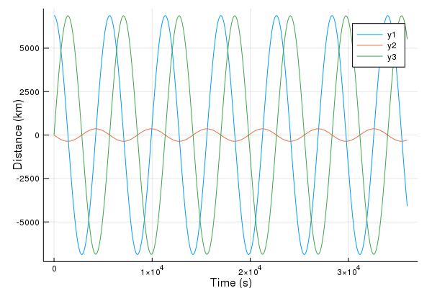
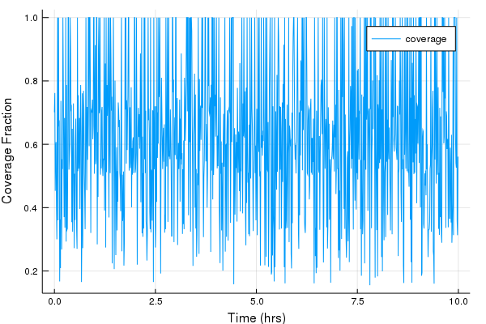
Satellite Coverage Simulation
RK4 orbit propagator
Monte Carlo ground users
2000 kilometer link allocation
Total estimated coverage
Maximum revisit time
Greedy sighting

Slide 4
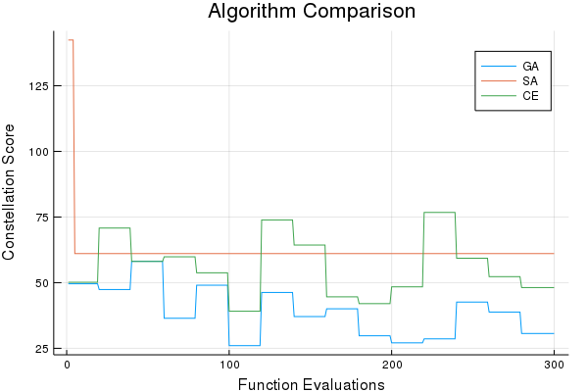
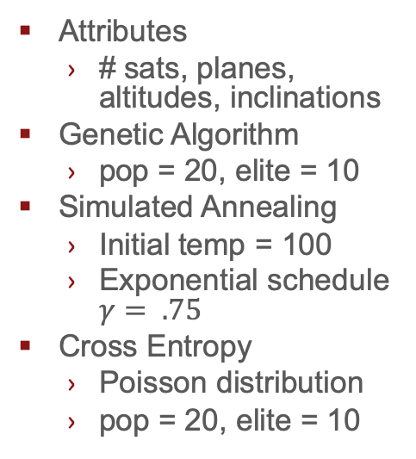
Results
Attributes
# sats, planes, altitudes, inclinations
Genetic Algorithm
pop = 20, elite = 10
Simulated Annealing
Initial temp = 100
Exponential schedule $γ= .75$
Cross Entropy
Poisson distribution
pop = 20, elite = 10

